Slide 1

NETWORK PROJECT
מגישים : טארק חוסין , וסאם קבהא

Slide 2
Project Overview
Chat app with client and server ,That supports downloading files from server using a custom Reliable UDP , Implementing some of RDT concepts
Data transfer was accomplished using json format

Slide 3
Gui & overall functionalty
Connect / Disconnect from the server (over TCP)
Send Private / Public messages (over TCP)
Get server files list (over TCP)
Get online users (over TCP)
Download files from the server (over Reliable UDP)
Updating online users
Download progress
Pause download
Select user to send private message

Slide 4
THE APP IN ACTION

Slide 5
Connecting , sending messages , downloading
FIRST, WE CONNECT TO THE SERVER .
GO TO CHAT ROOM TAB
SEND PUBLIC MESSAGES
DOWNLOAD FILE
PAUSE DOWNLOAD
CONTINUE DOWNLOAD

Slide 6
Private messages emojis
WHEN SENDING PRIVATE MESSAGE WE NEED TO SELECT THE DESIERD PERSON NAME FROM THE DROP BOX
ADDITIONATLY THERE IS A DROP BOX FOR ADDING AN EMOJI TO THE END OF THE MESSAGE

Slide 7
disconnecting
WHEN A USER DISCONNECT
HE WILL BE DELETED FROM THE SIDE WINDOW .

Slide 8
What has been done , IN CODE ?

Slide 9
Reliable udp
Go-Back-N algorithm
Congestion control , slow start (cwnd = 1 , ssthresh = 8)
Flow control
Cumulative Acknowledgements and Sequence Numbers
Utilization and Window Size
Timeout event
Duplicate ACK's Event
Close connection - (FIN,FINACK)
Exponential wegihted moving average , (timeout RTT)
Error detection - check sum

Slide 10
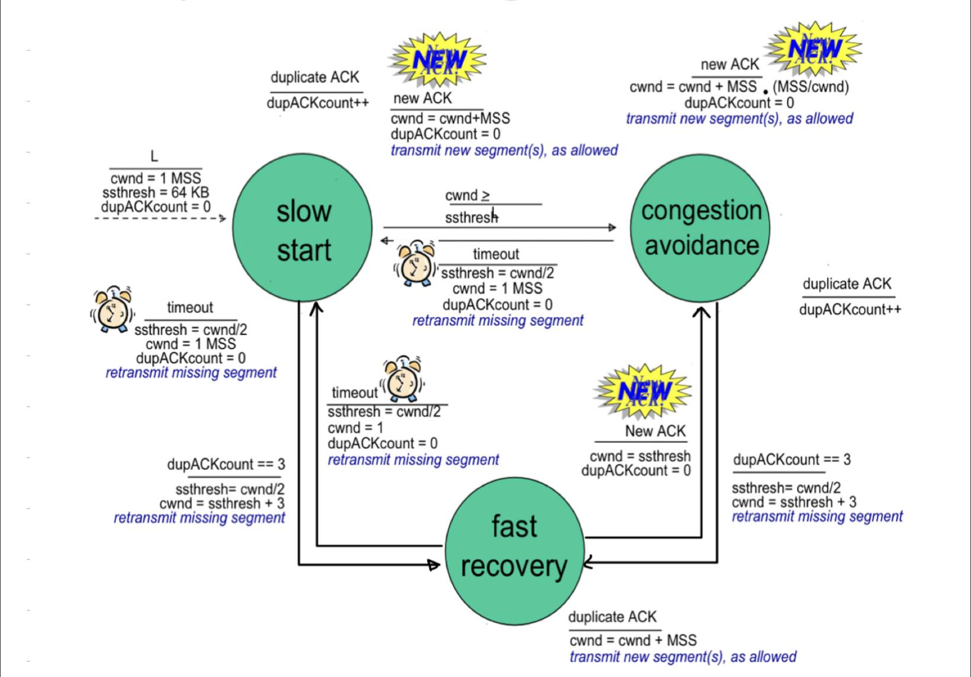
State machine

Slide 11
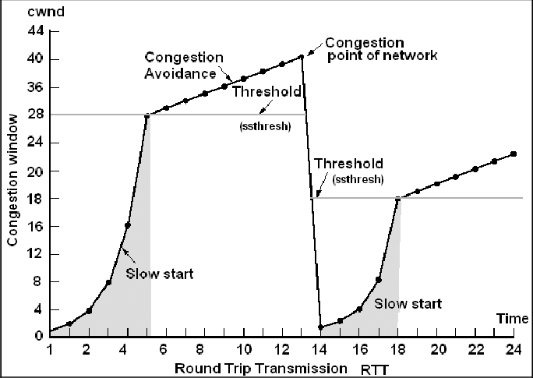
Congestion control slow start

Slide 12
How To Run
From the terminal :
Make sure to install PyQt5 python package
Pip install PyQt5
First run the server then the client
python client.py
python server.py

Slide 13
END

